Slide 1
Unit - III
Pulse and digital Modulation Techniques

Slide 2
DIGITAL-TO-DIGITAL CONVERSION
In this section, we see how we can represent digital data by using digital signals. The conversion involves three techniques: line coding, block coding, and scrambling. Line coding is always needed; block coding and scrambling may or may not be needed.
Topics
Line Coding
Line Coding Schemes
Block Coding
Scrambling

Slide 3
Line Coding
Converting a string of 1’s and 0’s (digital data) into a sequence of signals that denote the 1’s and 0’s.
For example a high voltage level (+V) could represent a “1” and a low voltage level (0 or -V) could represent a “0”.

Slide 4

Line coding and decoding

Slide 5
Mapping Data symbols onto Signal levels
A data symbol (or element) can consist of a number of data bits:
  1 , 0 or
  11, 10, 01, ……
A data symbol can be coded into a single signal element or multiple signal elements
  1 -> +V, 0 -> -V
  1 -> +V and -V, 0 -> -V and +V
The ratio ‘r’ is the number of data elements carried by a signal element.

Slide 6
Relationship between data rate and signal rate
The data rate defines the number of bits sent per sec - bps. It is often referred to the bit rate.
The signal rate is the number of signal elements sent in a second and is measured in bauds. It is also referred to as the modulation rate.
Goal is to increase the data rate whilst reducing the baud rate.

Slide 7

Signal element versus data element

Slide 8
Data rate and Baud rate
The baud or signal rate can be expressed as:
S = c x N x 1/r bauds
where N is data rate
c is the case factor (worst, best & avg.)
r is the ratio between data element & signal element

Slide 9

Example 1
A signal is carrying data in which one data element is encoded as one signal element ( r = 1). If the bit rate is 100 kbps, what is the average value of the baud rate if c is between 0 and 1?
Solution
We assume that the average value of c is 1/2 . The baud rate is then

Slide 10

Note
Although the actual bandwidth of a digital signal is infinite, the effective bandwidth is finite.

Slide 11
Considerations for choosing a good signal element referred to as line encoding
Baseline wandering - a receiver will evaluate the average power of the received signal (called the baseline) and use that to determine the value of the incoming data elements. If the incoming signal does not vary over a long period of time, the baseline will drift and thus cause errors in detection of incoming data elements.
A good line encoding scheme will prevent long runs of fixed amplitude.

Slide 12
Line encoding
DC components - when the voltage level remains constant for long periods of time, there is an increase in the low frequencies of the signal. Most channels are bandpass and may not support the low frequencies.
This will require the removal of the dc component of a transmitted signal.

Slide 13
Line encoding
Self synchronization - the clocks at the sender and the receiver must have the same bit interval.
If the receiver clock is faster or slower it will misinterpret the incoming bit stream.

Slide 14

Figure Effect of lack of synchronization

Slide 15
Example
In a digital transmission, the receiver clock is 0.1 percent faster than the sender clock. How many extra bits per second does the receiver receive if the data rate is
1 kbps? How many if the data rate is 1 Mbps?
Solution
At 1 kbps, the receiver receives 1001 bps instead of 1000 bps.
At 1 Mbps, the receiver receives 1,001,000 bps instead of 1,000,000 bps.

Slide 16
Line encoding
Error detection - errors occur during transmission due to line impairments.
Some codes are constructed such that when an error occurs it can be detected. For example: a particular signal transition is not part of the code. When it occurs, the receiver will know that a symbol error has occurred.

Slide 17
Line encoding
Noise and interference - there are line encoding techniques that make the transmitted signal “immune” to noise and interference.
This means that the signal cannot be corrupted, it is stronger than error detection.

Slide 18
Line encoding
Complexity - the more robust and resilient the code, the more complex it is to implement and the price is often paid in baud rate or required bandwidth.

Slide 19

Figure Line coding schemes

Slide 20
Unipolar
All signal levels are on one side of the time axis - either above or below
NRZ - Non Return to Zero scheme is an example of this code. The signal level does not return to zero during a symbol transmission.
Scheme is prone to baseline wandering and DC components. It has no synchronization or any error detection. It is simple but costly in power consumption.

Slide 21

Figure Unipolar NRZ scheme

Slide 22
Figure Line coding schemes

Slide 23
Polar - NRZ
The voltages are on both sides of the time axis.
Polar NRZ scheme can be implemented with two voltages. E.g. +V for 1 and -V for 0.
There are two versions:
  NRZ - Level (NRZ-L) - positive voltage for one symbol and negative for the other
  NRZ - Inversion (NRZ-I) - the change or lack of change in polarity determines the value of a symbol. E.g. a “1” symbol inverts the polarity a “0” does not.

Slide 24

Figure Polar NRZ-L and NRZ-I schemes

Slide 25
Note
In NRZ-L the level of the voltage determines the value of the bit.
In NRZ-I the inversion
or the lack of inversion
determines the value of the bit.

Slide 26
Note
NRZ-L and NRZ-I both have an average signal rate of N/2 Bd.

Slide 27
Note
NRZ-L and NRZ-I both have a DC component problem and baseline wandering, it is worse for NRZ-L. Both have no self synchronization &no error detection. Both are relatively simple to implement.

Slide 28
Polar - RZ
The Return to Zero (RZ) scheme uses three voltage values. +, 0, -.
Each symbol has a transition in the middle. Either from high to zero or from low to zero.
This scheme has more signal transitions (two per symbol) and therefore requires a wider bandwidth.
No DC components or baseline wandering.
Self synchronization - transition indicates symbol value.
More complex as it uses three voltage level. It has no error detection capability.

Slide 29

Figure Polar RZ scheme

Slide 30
Figure Line coding schemes

Slide 31
Polar - Biphase: Manchester and Differential Manchester
Manchester coding consists of combining the NRZ-L and RZ schemes.
  Every symbol has a level transition in the middle: from high to low or low to high. Uses only two voltage levels.
Differential Manchester coding consists of combining the NRZ-I and RZ schemes.
  Every symbol has a level transition in the middle. But the level at the beginning of the symbol is determined by the symbol value. One symbol causes a level change the other does not.

Slide 32

Figure Polar biphase: Manchester and differential
Manchester schemes

Slide 33
Note
In Manchester and differential Manchester encoding, the transition
at the middle of the bit is used for synchronization.

Slide 34
Note
The minimum bandwidth of Manchester and differential Manchester is 2 times that of NRZ. The is no DC component and no baseline wandering. None of these codes has error detection.

Slide 35
Figure Line coding schemes

Slide 36
Bipolar - AMI and Pseudoternary
Code uses 3 voltage levels: - +, 0, -, to represent the symbols (note not transitions to zero as in RZ).
Voltage level for one symbol is at “0” and the other alternates between + & -.
Bipolar Alternate Mark Inversion (AMI) - the “0” symbol is represented by zero voltage and the “1” symbol alternates between +V and -V.
Pseudoternary is the reverse of AMI.

Slide 37

Figure Bipolar schemes: AMI and pseudoternary

Slide 38
Bipolar
It is a better alternative to NRZ.
Has no DC component or baseline wandering.
Has no self synchronization because long runs of “0”s results in no signal transitions.
No error detection.

Slide 39
Figure Line coding schemes

Slide 40
Multilevel Schemes
In these schemes we increase the number of data bits per symbol thereby increasing the bit rate.
Since we are dealing with binary data we only have 2 types of data element a 1 or a 0.
We can combine the 2 data elements into a pattern of “m” elements to create “2^{m}” symbols.
If we have L signal levels, we can use “n” signal elements to create L^{n} signal elements.

Slide 41
Code
Now we have 2^{m} symbols and L^{n} signals.
If 2^{m} > L^{n} then we cannot represent the data elements, we don’t have enough signals.
If 2^{m} = L^{n} then we have an exact mapping of one symbol on one signal.
If 2^{m} < L^{n} then we have more signals than symbols and we can choose the signals that are more distinct to represent the symbols and therefore have better noise immunity and error detection as some signals are not valid.

Slide 42
Note
In mBnL schemes, a pattern of m data elements is encoded as a pattern of n signal elements in which 2^{m} ≤ L^{n}.

Slide 43
Representing Multilevel Codes
We use the notation mBnL, where m is the length of the binary pattern, B represents binary data, n represents the length of the signal pattern and L the number of levels.
L = B binary, L = T for 3 ternary, L = Q for 4 quaternary.

Slide 44

Figure Multilevel: 2B1Q scheme

Slide 45
Redundancy
In the 2B1Q scheme we have no redundancy and we see that a DC component is present.
If we use a code with redundancy we can decide to use only “0” or “+” weighted codes (more +’s than -’s in the signal element) and invert any code that would create a DC component. E.g. ‘+00++-’ -> ‘-00--+’
Receiver will know when it receives a “-” weighted code that it should invert it as it doesn’t represent any valid symbol.

Slide 46

Figure Multilevel: 8B6T scheme

Slide 47
Multilevel using multiple channels
In some cases, we split the signal transmission up and distribute it over several links.
The separate segments are transmitted simultaneously. This reduces the signalling rate per link -> lower bandwidth.
This requires all bits for a code to be stored.
xD: means that we use ‘x’ links
YYYz: We use ‘z’ levels of modulation where YYY represents the type of modulation (e.g. pulse ampl. mod. PAM).
Codes are represented as: xD-YYYz

Slide 48

Figure Multilevel: 4D-PAM5 scheme

Slide 49
Figure Line coding schemes

Slide 50
Multitransition Coding
Because of synchronization requirements we force transitions. This can result in very high bandwidth requirements -> more transitions than are bits (e.g. mid bit transition with inversion).
Codes can be created that are differential at the bit level forcing transitions at bit boundaries. This results in a bandwidth requirement that is equivalent to the bit rate.
In some instances, the bandwidth requirement may even be lower, due to repetitive patterns resulting in a periodic signal.

Slide 51

Figure Multitransition: MLT-3 scheme

Slide 52
MLT-3
Signal rate is same as NRZ-I
But because of the resulting bit pattern, we have a periodic signal for worst case bit pattern: 1111
This can be approximated as an analog signal a frequency 1/4 the bit rate!

Slide 53


Table Summary of line coding schemes

Slide 54
Block Coding
For a code to be capable of error detection, we need to add redundancy, i.e., extra bits to the data bits.
Synchronization also requires redundancy - transitions are important in the signal flow and must occur frequently.
Block coding is done in three steps: division, substitution and combination.
It is distinguished from multilevel coding by use of the slash - xB/yB.
The resulting bit stream prevents certain bit combinations that when used with line encoding would result in DC components or poor sync. quality.

Slide 55
Note
Block coding is normally referred to as mB/nB coding;
it replaces each m-bit group with an
n-bit group.

Slide 56

Figure Block coding concept

Slide 57

Figure Using block coding 4B/5B with NRZ-I line
coding scheme

Slide 58
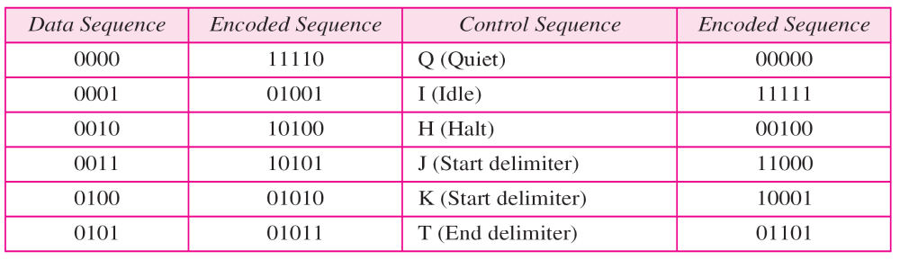

Table 4B/5B mapping codes

Slide 59

Figure Substitution in 4B/5B block coding

Slide 60
More bits - better error detection
The 8B10B block code adds more redundant bits and can thereby choose code words that would prevent a long run of a voltage level that would cause DC components.

Slide 61
Scrambling
The best code is one that does not increase the bandwidth for synchronization and has no DC components.
Scrambling is a technique used to create a sequence of bits that has the required c/c’s for transmission - self clocking, no low frequencies, no wide bandwidth.
It is implemented at the same time as encoding, the bit stream is created on the fly.
It replaces ‘unfriendly’ runs of bits with a violation code that is easy to recognize and removes the unfriendly c/c.

Slide 62

Figure AMI used with scrambling

Slide 63
ANALOG-TO-DIGITAL CONVERSION
A digital signal is superior to an analog signal because it is more robust to noise and can easily be recovered, corrected and amplified. For this reason, the tendency today is to change an analog signal to digital data. In this section we describe two techniques, pulse code modulation and delta modulation.
Topics :
Pulse Code Modulation (PCM)
Delta Modulation (DM)
Differential Pulse Code Modulation (DPCM)

Slide 64
PCM
PCM consists of three steps to digitize an analog signal:
  Sampling
  Quantization
  Binary encoding
Before we sample, we have to filter the signal to limit the maximum frequency of the signal as it affects the sampling rate.
Filtering should ensure that we do not distort the signal, ie remove high frequency components that affect the signal shape.

Slide 65

Figure Components of PCM encoder

Slide 66
Sampling
Analog signal is sampled every T_{S} secs.
T_{s} is referred to as the sampling interval.
f_{s} = 1/T_{s} is called the sampling rate or sampling frequency.
There are 3 sampling methods:
  Ideal - an impulse at each sampling instant
  Natural - a pulse of short width with varying amplitude
  Flattop - sample and hold, like natural but with single amplitude value
The process is referred to as pulse amplitude modulation PAM and the outcome is a signal with analog (non integer) values

Slide 67

Figure Three different sampling methods for PCM

Slide 68
Note
According to the Nyquist theorem, the sampling rate must be
at least 2 times the highest frequency contained in the signal.

Slide 69

Figure Nyquist sampling rate for low-pass and bandpass signals

Slide 70

Figure Recovery of a sampled sine wave for
different sampling rates

Slide 71
Example
A complex low-pass signal has a bandwidth of 200 kHz. What is the minimum sampling rate for this signal?
Solution
The bandwidth of a low-pass signal is between 0 and f, where f is the maximum frequency in the signal. Therefore, we can sample this signal at 2 times the highest frequency (200 kHz). The sampling rate is therefore 400,000 samples per second.

Slide 72
Quantization
Sampling results in a series of pulses of varying amplitude values ranging between two limits: a min and a max.
The amplitude values are infinite between the two limits.
We need to map the infinite amplitude values onto a finite set of known values.

Slide 73
Bit rate and bandwidth requirements of PCM
The bit rate of a PCM signal can be calculated form the number of bits per sample x the sampling rate
Bit rate = n_{b} x f_{s}
The bandwidth required to transmit this signal depends on the type of line encoding used
A digitized signal will always need more bandwidth than the original analog signal.

Slide 74

Example
We want to digitize the human voice. What is the bit rate, assuming 8 bits per sample?
Solution
The human voice normally contains frequencies from 0 to 4000 Hz. So the sampling rate and bit rate are calculated as follows:

Slide 75
PCM Decoder
To recover an analog signal from a digitized signal we follow the following steps:
  We use a hold circuit that holds the amplitude value of a pulse till the next pulse arrives.
  We pass this signal through a low pass filter with a cutoff frequency that is equal to the highest frequency in the pre-sampled signal.

Slide 76

Figure Components of a PCM decoder

Slide 77
Delta Modulation
This scheme sends only the difference between pulses, if the pulse at time t_{n+1} is higher in amplitude value than the pulse at time t_{n}, then a single bit, say a “1”, is used to indicate the positive value.
If the pulse is lower in value, resulting in a negative value, a “0” is used.
This scheme works well for small changes in signal values between samples.
If changes in amplitude are large, this will result in large errors.

Slide 78

Figure The process of delta modulation

Slide 79

Figure Delta modulation components

Slide 80

Figure Delta demodulation components

Slide 81
Differential pulse code modulation
(DPCM)
n DPCM instead of transmitting digital equivalent of each quantized sampled signal the difference between the present sample value and previously sampled value is transmitted.

Slide 82
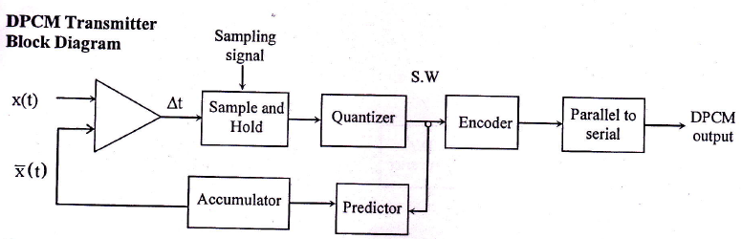
DPCM Generator

Slide 83
Advantages of DPCM
Less signaling rate.
Less bandwidth.
Disadvantages of DPCM
High bit rate.
Needs the predictor circuit to be used which is complex.

Slide 84
Information & Entropy

Slide 85
Information & Entropy
Information Equation
I(p) = - logb (p)
p = probability of the event happening
b = base
(base 2 is mostly used in information theory)
*unit of information is determined by base
base 2 = bits
base 3 = trits
base 10 = Hartleys
base e = nats

Slide 86
Information & Entropy
Example of Calculating Information
Coin Toss
There are two probabilities in fair coin, which
are head(.5) and tail(.5).
So if you get either head or tail you will get 1
bit of information through following formula.
I(head) = - log (.5) = 1 bit

Slide 87
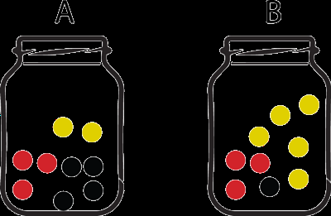
Information & Entropy
Another Example
Balls in the bin
The information you will get by choosing a ball
from the bin are calculated as following.
I(black ball) = - log(4/9) = 1.1699 bits
I(yellow ball) = - log(2/9) = 2.1699 bits
I(red ball) = - log(3/9) = 1.58496 bits

Slide 88
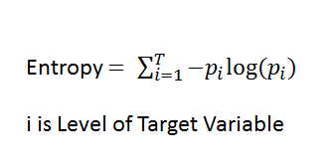
Information & Entropy
Then, what is Entropy?
- Entropy is simply the average(expected) amount
of the information from the event.
• Entropy Equation
n = number of different outcomes

Slide 89
Information & Entropy
Let’s look at this example again...
Calculating the entropy....
In this example there are three outcomes possible
when you choose the ball, it can be either red, yellow,
or black. (n = 3)
So the equation will be following.
Entropy = - (4/9) log(4/9) + -(2/9) log(2/9) + - (3/9) log(3/9) = 1.530475
Therefore, you are expected to get 1.5304755
information each time you choose a ball from the bin

Slide 90
Clear things up.
Does Entropy have range from 0 to 1?
– No. However, the range is set based on the number of outcomes.
– Equation for calculating the range of Entropy:
0 ≤ Entropy ≤ log(n), where n is number of outcomes
– Entropy 0(minimum entropy) occurs when one of the probabilities is 1 and rest are 0’s
– Entropy log(n)(maximum entropy) occurs when all the probabilities have equal values of 1/n.

Slide 91
Source coding
Data compression

Slide 92
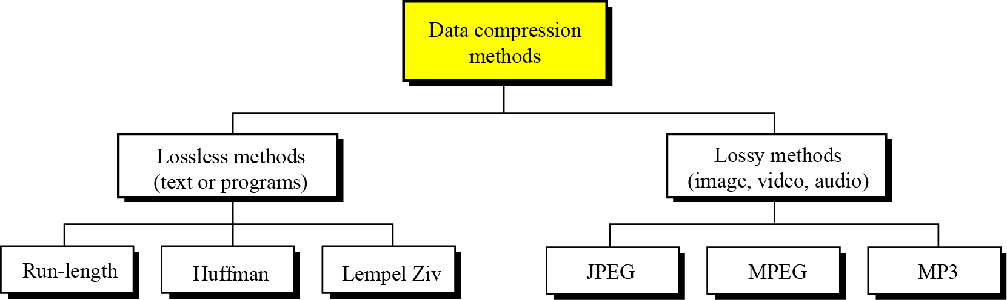
Data compression implies sending or storing a smaller number of bits. Although many methods are used for this purpose, in general these methods can be divided into two broad categories: lossless and lossy methods.
Data compression methods

Slide 93
Run Length Coding

Slide 94
Introduction – What is RLC?
Compression technique
  Represents data using value and run length
  Run length defined as number of consecutive equal values
  e.g
  1110011111 1 3 0 2 1 5
RLE
Values
Run Lengths

Slide 95
Introduction
Compression effectiveness depends on input
Must have consecutive runs of values in order to maximize compression
  Best case: all values same
    Can represent any length using two values
  Worst case: no repeating values
    Compressed data twice the length of original!!
Should only be used in situations where we know for sure have repeating values

Slide 96
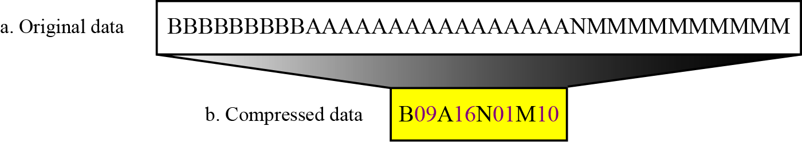
Run-length encoding example

Slide 97
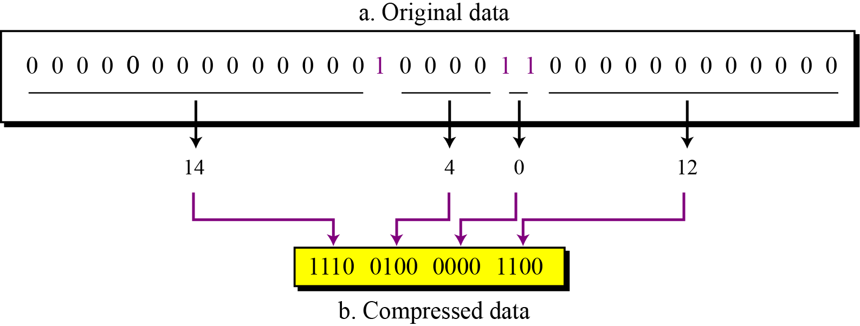
Run-length encoding for two symbols

Slide 98
Huffman Coding

Slide 99
Huffman Codes
Invented by Huffman as a class assignment in 1950.
Used in many, if not most compression algorithms such as gzip, bzip, jpeg (as option), fax compression,…
Properties:
  Generates optimal prefix codes
  Cheap to generate codes
  Cheap to encode and decode
  l_{a}=H if probabilities are powers of 2

Slide 100
Huffman Codes
Huffman Algorithm
Start with a forest of trees each consisting of a single vertex corresponding to a message s and with weight p(s)
Repeat:
  Select two trees with minimum weight roots p₁ and p₂
  Join into single tree by adding root with weight p₁ + p₂

Slide 101
Example
p(a) = .1, p(b) = .2, p(c ) = .2, p(d) = .5
a(.1)
b(.2)
c(.2)
d(.5)
(.3)
(.5)
(1.0)
0
1
a(.1)
b(.2)
(.5)
d(.5)
(.3)
c(.2)
0
1
Step 1
(.3)
c(.2)
a(.1)
b(.2)
0
1
Step 2
a(.1)
b(.2)
Step 3

Slide 102
Encoding and Decoding
Encoding: Start at leaf of Huffman tree and follow path to the root. Reverse order of bits and send.
Decoding: Start at root of Huffman tree and take branch for each bit received. When at leaf can output message and return to root.
(1.0)
0
1
There are even faster methods that can process 8 or 32 bits at a time
(.5)
d(.5)
0
1
(.3)
c(.2)
0
1
a(.1)
b(.2)

Slide 103
Huffman codes Pros & Cons
Pros:
  The Huffman algorithm generates an optimal prefix code.
Cons:
  If the ensemble changes→ the frequencies and probabilities change → the optimal coding changes
  e.g. in text compression symbol frequencies vary with context
  Re-computing the Huffman code by running through the entire file in advance?!

Slide 104
Lempel-Ziv (LZ77)

Slide 105
Lempel-Ziv Algorithms
LZ77 (Sliding Window)
Variants: LZSS (Lempel-Ziv-Storer-Szymanski)
Applications: gzip, Squeeze, LHA, PKZIP, ZOO
LZ78 (Dictionary Based)
Variants: LZW (Lempel-Ziv-Welch),
LZC (Lempel-Ziv-Compress)
Applications:
compress, GIF, CCITT (modems), ARC, PAK
Traditionally LZ77 was better but slower, but the gzip version is almost as fast as any LZ78.

Slide 106
Lempel Ziv (LZ) encoding
→ is an example of a category of algorithms called dictionary-based encoding.
→ The idea is to create a dictionary (a table) of strings used during the communication session.
→ If both the sender and the receiver have a copy of the dictionary, then previously-encountered strings can be substituted by their index in the dictionary to reduce the amount of information transmitted.

Slide 107
Compression
In this phase there are two concurrent events:
→ building an indexed dictionary and compressing a string of symbols.
→ The algorithm extracts the smallest substring that cannot be found in the dictionary from the remaining uncompressed string.
→ It then stores a copy of this substring in the dictionary as a new entry and assigns it an index value.
→ Compression occurs when the substring, except for the last character, is replaced with the index found in the dictionary.
→ The process then inserts the index and the last character of the substring into the compressed string.

Slide 108
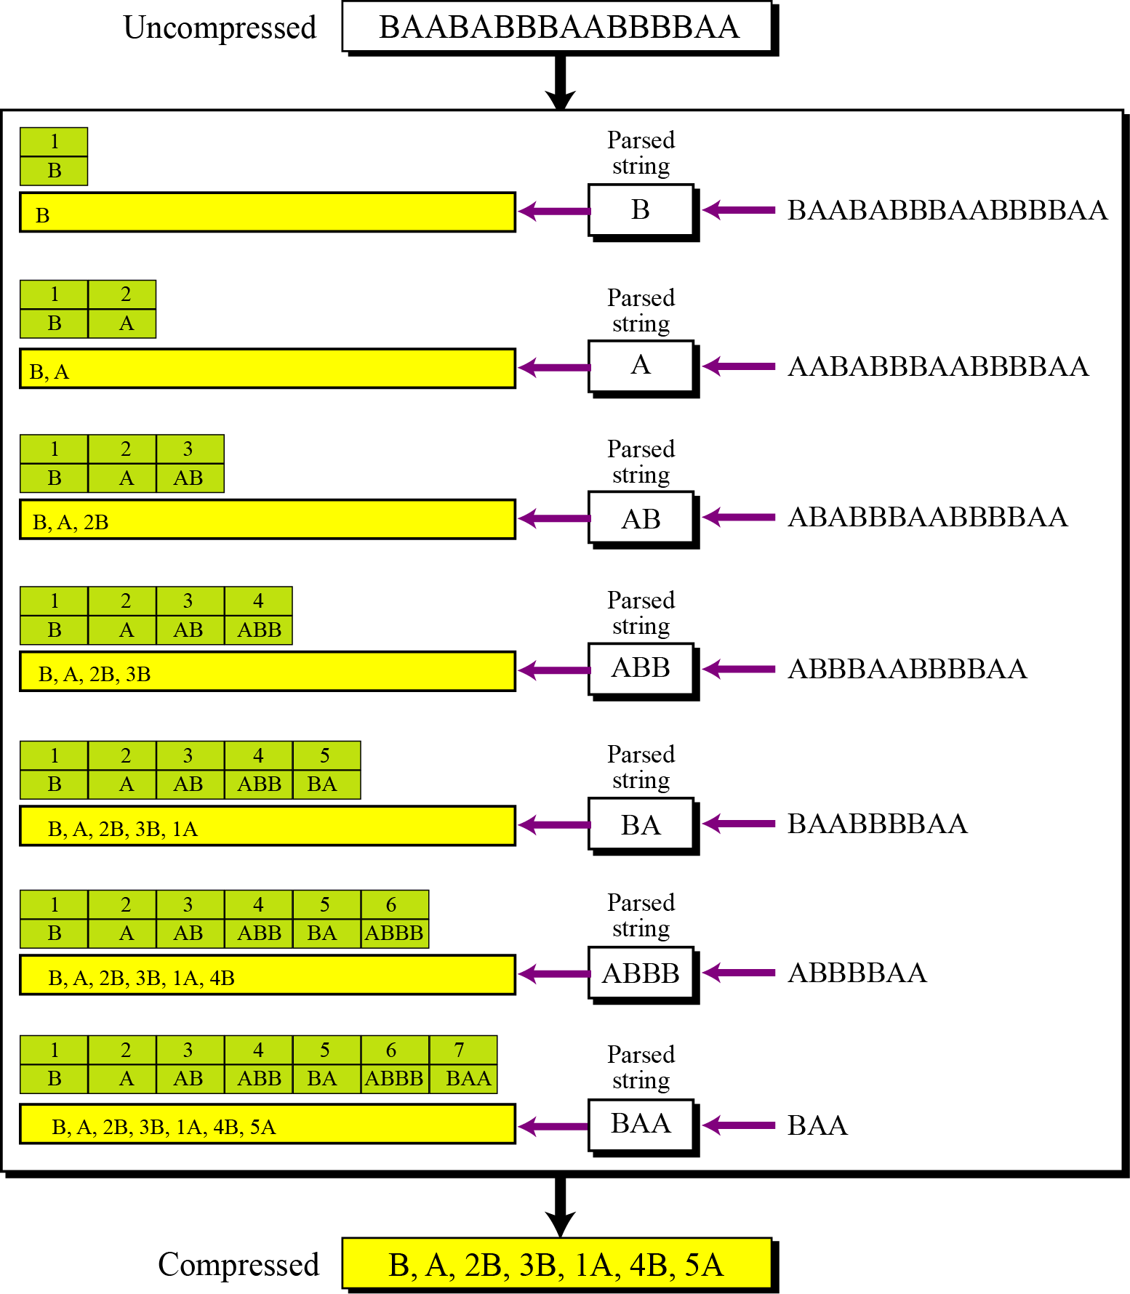
An example of Lempel Ziv encoding

Slide 109
Decompression
→ Decompression is the inverse of the compression process.
→ The process extracts the substrings from the compressed string and tries to replace the indexes with the corresponding entry in the dictionary,
→ which is empty at first and built up gradually.
→ The idea is that when an index is received, there is already an entry in the dictionary corresponding to that index.

Slide 110
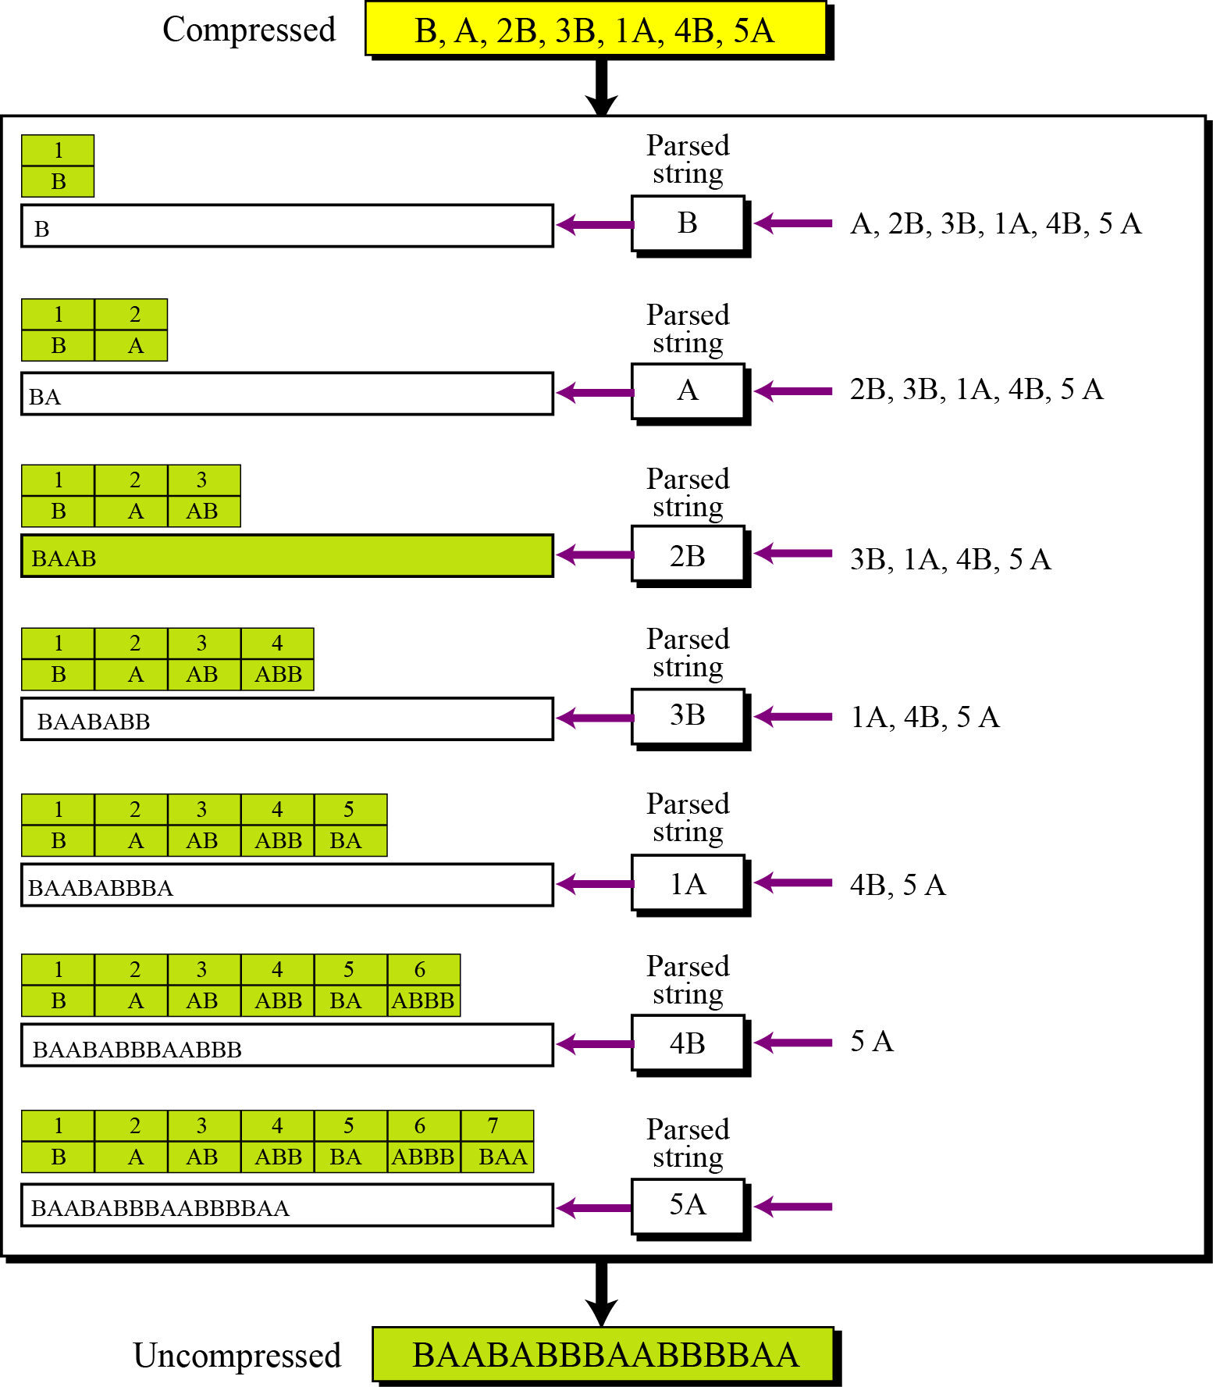
An example of Lempel Ziv decoding

Slide 111
TRANSMISSION MODES
The transmission of binary data across a link can be accomplished in either parallel or serial mode. In parallel mode, multiple bits are sent with each clock tick. In serial mode, 1 bit is sent with each clock tick. While there is only one way to send parallel data, there are three subclasses of serial transmission: asynchronous, synchronous, and isochronous.
Topics :
Parallel Transmission
Serial Transmission

Slide 112

Figure Data transmission and modes

Slide 113

Figure Parallel transmission

Slide 114

Figure Serial transmission

Slide 115
Note
In asynchronous transmission, we send 1 start bit (0) at the beginning and 1 or more stop bits (1s) at the end of each byte. There may be a gap between
each byte.

Slide 116
Note
Asynchronous here means “asynchronous at the byte level,”
but the bits are still synchronized;
their durations are the same.

Slide 117

Figure Asynchronous transmission

Slide 118
Note
In synchronous transmission, we send bits one after another without start or stop bits or gaps. It is the responsibility of the receiver to group the bits. The bits are usually sent as bytes and many bytes are grouped in a frame. A frame is identified with a start and an end byte.

Slide 119

Figure Synchronous transmission

Slide 120
Isochronous
In isochronous transmission we cannot have uneven gaps between frames.
Transmission of bits is fixed with equal gaps.

Slide 121
_{DIGITAL-TO-ANALOG CONVERSION}
Digital-to-analog conversion is the process of changing one of the characteristics of an analog signal based on the information in digital data.
_{Topics :}
Aspects of Digital-to-Analog Conversion
_{Amplitude Shift Keying}
_{Frequency Shift Keying}
_{Phase Shift Keying}
Quadrature Amplitude Modulation

Slide 122
Digital to Analog Conversion
Digital data needs to be carried on an analog signal.
A carrier signal (frequency f_{c}) performs the function of transporting the digital data in an analog waveform.
The analog carrier signal is manipulated to uniquely identify the digital data being carried.

Slide 123

_{Digital-to-analog conversion}

Slide 124

Types of digital-to-analog conversion

Slide 125
_{Note}
Bit rate, N, is the number of bits per second (bps).
Baud rate is the number of signal elements per second (bauds).
In the analog transmission of digital data, the signal or baud rate is less than
_{or equal to the bit rate.}
_{S=Nx1/r bauds}
Where r is the number of data bits per signal element.

Slide 126
_{Example}
An analog signal carries 4 bits per signal element. If 1000 signal elements are sent per second, find the bit rate.
_{Solution}
In this case, r = 4, S = 1000, and N is unknown. We can find the value of N from

Slide 127
Amplitude Shift Keying (ASK)
ASK is implemented by changing the amplitude of a carrier signal to reflect amplitude levels in the digital signal.
For example: a digital “1” could not affect the signal, whereas a digital “0” would, by making it zero.
The line encoding will determine the values of the analog waveform to reflect the digital data being carried.

Slide 128
Bandwidth of ASK
The bandwidth B of ASK is proportional to the signal rate S.
B = (1+d)S
“d” is due to modulation and filtering, lies between 0 and 1.

Slide 129

_{Binary amplitude shift keying}

Slide 130

_{Implementation of binary ASK}

Slide 131

_{Example}
In data communications, we normally use full-duplex links with communication in both directions. We need to divide the bandwidth into two with two carrier frequencies. The figure shows the positions of two carrier frequencies and the bandwidths. The available bandwidth for each direction is now 50 kHz, which leaves us with a data rate of 25 kbps in each direction.
_{Bandwidth of full-duplex ASK}

Slide 132
Frequency Shift Keying
The digital data stream changes the frequency of the carrier signal, f_{c}.
For example, a “1” could be represented by f₁=f_{c} +Δf, and a “0” could be represented by f₂=f_{c}-Δf.

Slide 133

_{Binary frequency shift keying}

Slide 134
Bandwidth of FSK
If the difference between the two frequencies (f₁ and f₂) is 2Δf, then the required BW B will be:
B = (1+d)xS +2Δf

Slide 135
_{Example}
We have an available bandwidth of 100 kHz which spans from 200 to 300 kHz. What should be the carrier frequency and the bit rate if we modulated our data by using FSK with d = 1?
_{Solution}
This problem is similar to the previous example , but we are modulating by using FSK. The midpoint of the band is at 250 kHz. We choose 2Δf to be 50 kHz; this means

Slide 136
Coherent and Non Coherent
In a non-coherent FSK scheme, when we change from one frequency to the other, we do not adhere to the current phase of the signal.
In coherent FSK, the switch from one frequency signal to the other only occurs at the same phase in the signal.

Slide 137
Multi level FSK
Similarly to ASK, FSK can use multiple bits per signal element.
That means we need to provision for multiple frequencies, each one to represent a group of data bits.
The bandwidth for FSK can be higher

Slide 138

_{Bandwidth of MFSK}

Slide 139

_{Example}
We need to send data 3 bits at a time at a bit rate of 3 Mbps. The carrier frequency is 10 MHz. Calculate the number of levels (different frequencies), the baud rate, and the bandwidth.
_{Solution}
_{We can have L = 2}³ = 8. The baud rate is S = 3 Mbps/3 = 1 Mbaud. This means that the carrier frequencies must be 1 MHz apart (2Δf = 1 MHz). The bandwidth is B = 8 × 1M = 8M. Figure shows the allocation of frequencies and bandwidth.
_{Bandwidth of MFSK}

Slide 140
Phase Shift Keying
We vary the phase shift of the carrier signal to represent digital data.
The bandwidth requirement, B is:
B = (1+d)xS
PSK is much more robust than ASK as it is not that vulnerable to noise, which changes amplitude of the signal.

Slide 141

_{Binary phase shift keying}

Slide 142

_{Implementation of BPSK}

Slide 143
Quadrature PSK
To increase the bit rate, we can code 2 or more bits onto one signal element.
In QPSK, we parallelize the bit stream so that every two incoming bits are split up and PSK a carrier frequency. One carrier frequency is phase shifted 90º from the other - in quadrature.
The two PSKed signals are then added to produce one of 4 signal elements. L = 4 here.

Slide 144

_{QPSK and its implementation}

Slide 145
_{Example}
Find the bandwidth for a signal transmitting at 12 Mbps for QPSK. The value of d = 0.
_{Solution}
For QPSK, 2 bits is carried by one signal element. This means that r = 2. So the signal rate (baud rate) is S = N × (1/r) = 6 Mbaud. With a value of d = 0, we have B = S = 6 MHz.

Slide 146
Constellation Diagrams
A constellation diagram helps us to define the amplitude and phase of a signal when we are using two carriers, one in quadrature of the other.
The X-axis represents the in-phase carrier and the Y-axis represents quadrature carrier.

Slide 147

Concept of a constellation diagram

Slide 148

_{Example}
Show the constellation diagrams for an ASK , BPSK, and QPSK signals.
_{Solution}
Figure shows the three constellation diagrams.

Slide 149
_{Note}
Quadrature amplitude modulation is a combination of ASK and PSK.

Slide 150

Constellation diagrams for some QAMs

Slide 151
_{ANALOG AND DIGITAL}
Analog-to-analog conversion is the representation of analog information by an analog signal. One may ask why we need to modulate an analog signal; it is already analog. Modulation is needed if the medium is bandpass in nature or if only a bandpass channel is available to us.
_{Topics}
_{Amplitude Modulation}
_{Frequency Modulation}
_{Phase Modulation}

Slide 152

Types of analog-to-analog modulation

Slide 153
Amplitude Modulation
A carrier signal is modulated only in amplitude value
The modulating signal is the envelope of the carrier
The required bandwidth is 2B, where B is the bandwidth of the modulating signal
Since on both sides of the carrier freq. f_{c}, the spectrum is identical, we can discard one half, thus requiring a smaller bandwidth for transmission.

Slide 154

_{Amplitude modulation}

Slide 155
_{Note}
The total bandwidth required for AM can be determined from the bandwidth of the audio signal:
_{BAM = 2B}

Slide 156

_{AM band allocation}

Slide 157
Frequency Modulation
The modulating signal changes the freq. f_{c} of the carrier signal
The bandwidth for FM is high
It is approx. 10x the signal frequency

Slide 158
_{Note}
The total bandwidth required for FM can be determined from the bandwidth
_{of the audio signal:}
_{BFM = 2(1 + β)B}
_{Where β is usually 4}

Slide 159

_{Frequency modulation}

Slide 160

_{FM band allocation}

Slide 161
Phase Modulation (PM)
The modulating signal only changes the phase of the carrier signal.
The phase change manifests itself as a frequency change but the instantaneous frequency change is proportional to the derivative of the amplitude.
The bandwidth is higher than for AM.

Slide 162

_{Phase modulation}

Slide 163
_{Note}
The total bandwidth required for PM can be determined from the bandwidth
and maximum amplitude of the modulating signal:
_{BPM = 2(1 + β)B}
_{Where β = 2 most often}

Slide 164
_{Note}
Bandwidth utilization is the wise use of available bandwidth to achieve specific goals.
Efficiency can be achieved by multiplexing; i.e., sharing of the bandwidth between multiple users.

Slide 165



